Slide 1
Little Green reading Badge Competition
2019-2020

Slide 2
REASON for badge competition
PREMISES:
Promotes power of children – “You are never to small to make a difference!”
Promotes having a go – “Your playing small does not serve the world.”
Promotes fairness – “Equality of Opportunity!”
Promotes Attitude to Learning – “Practice makes BETTER!”
If you are not a winner this time – what will you do about it? Give up? Or look at the winning entries and learn from them –
What can you do next time?!

Slide 3
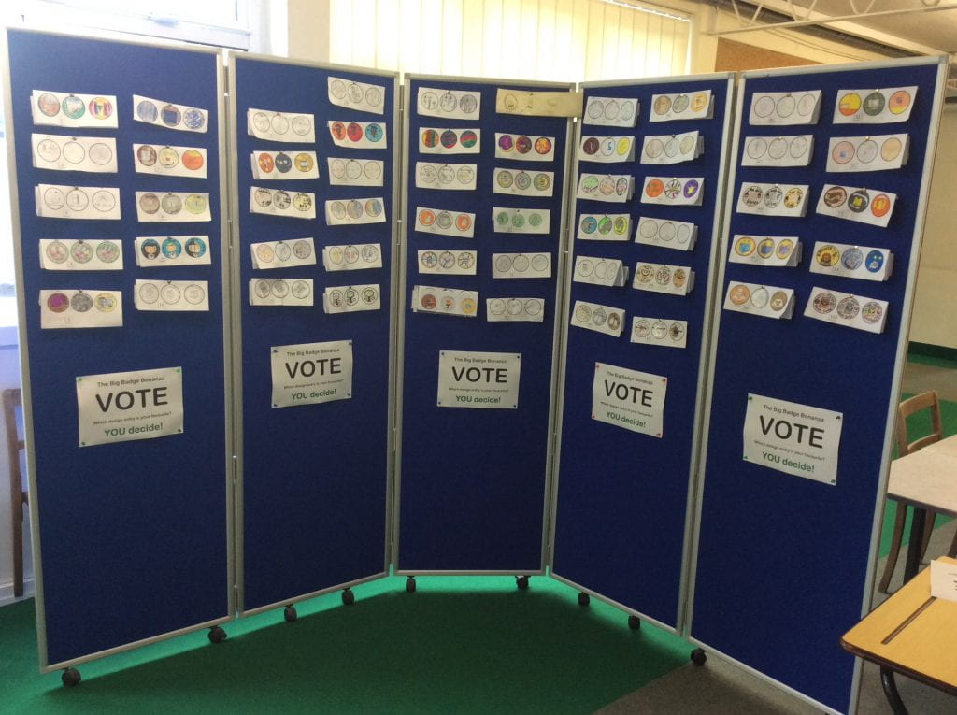
Some amazing entries…

Slide 4
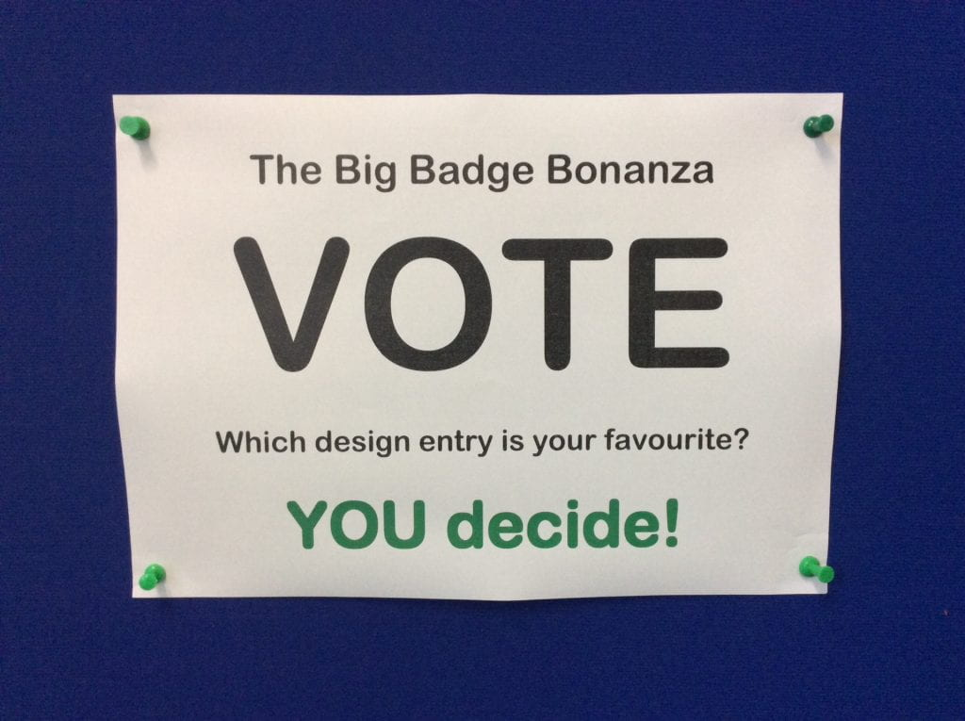
You Voted and decided…

Slide 5
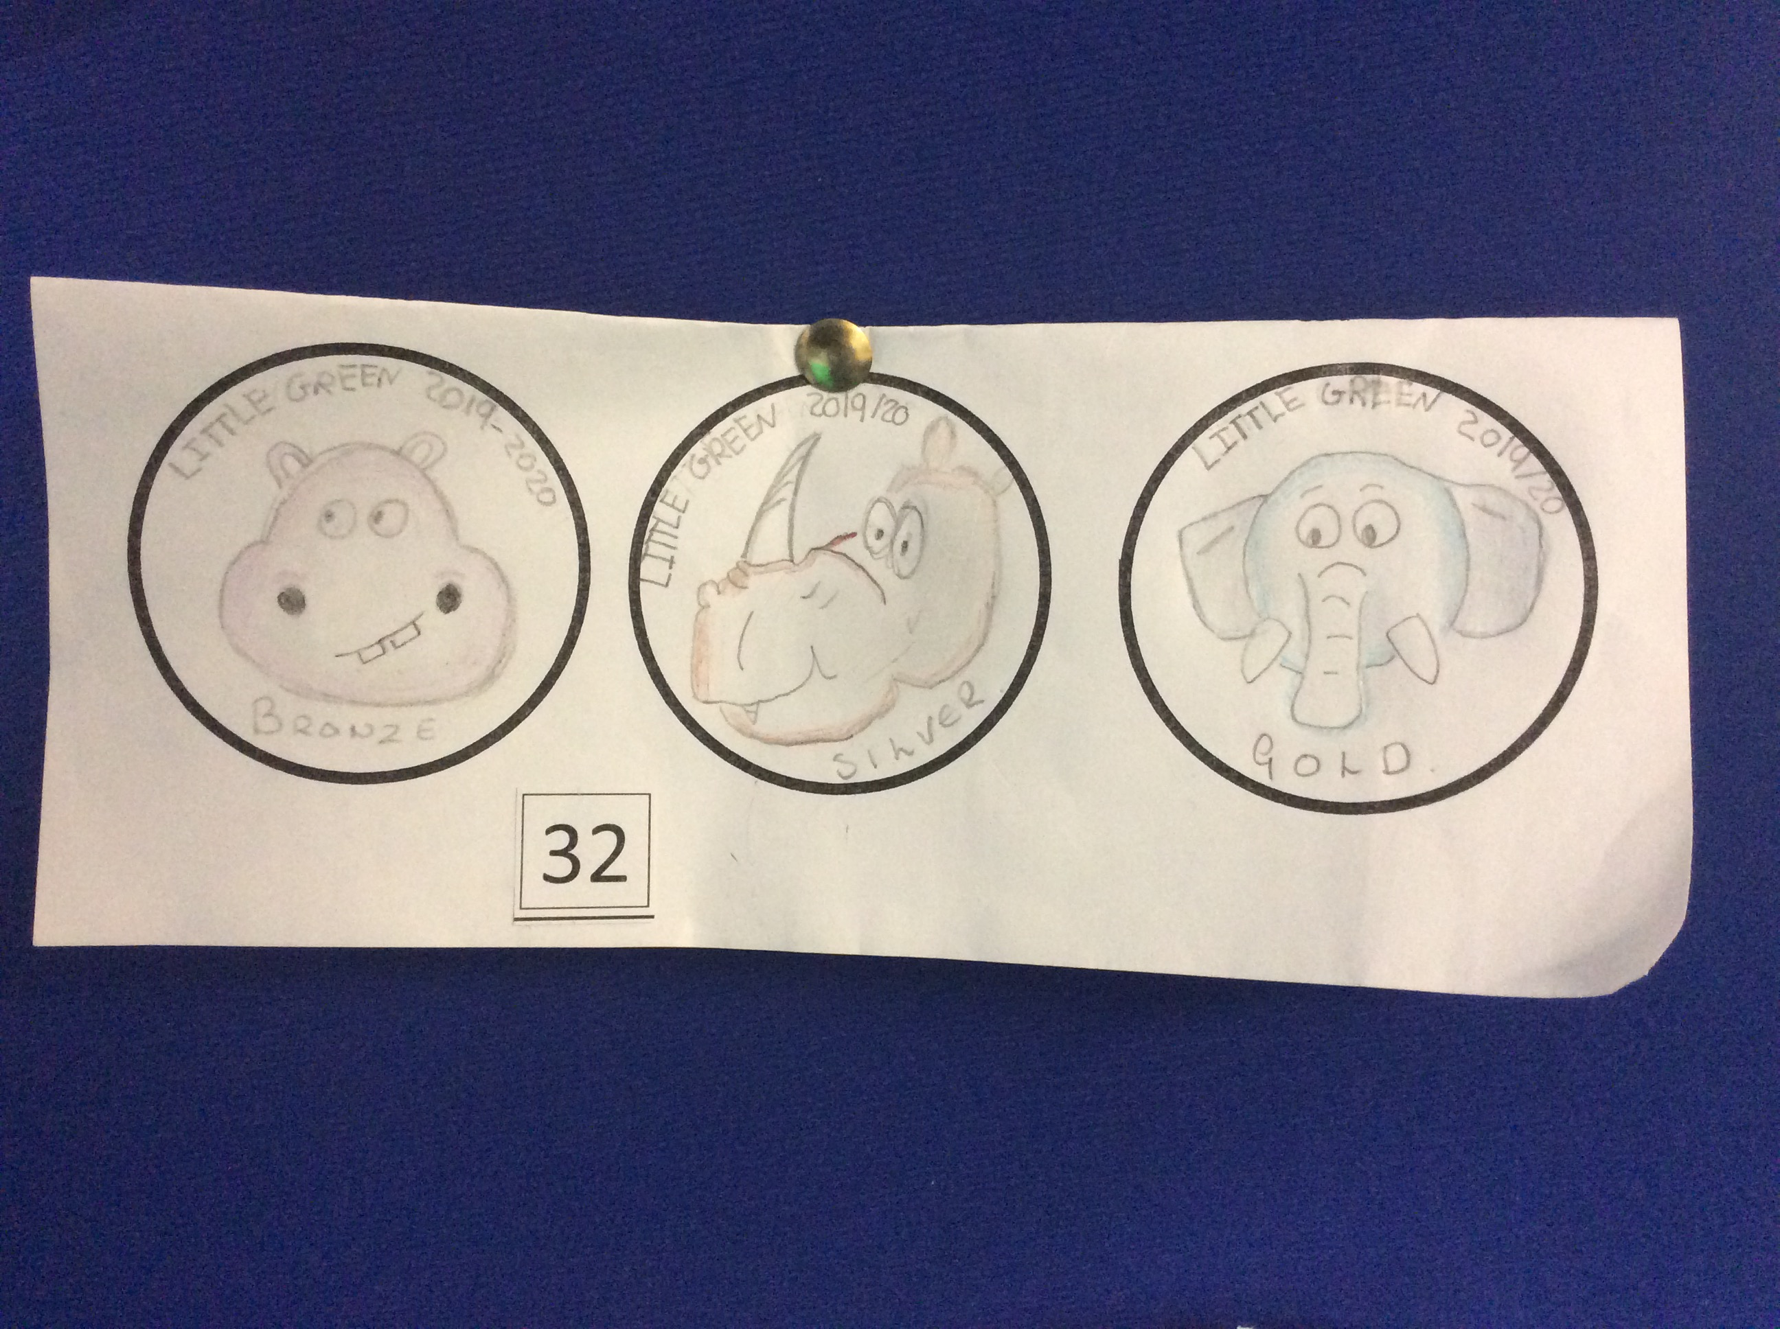
In 5th place
Isla
4H

Slide 6
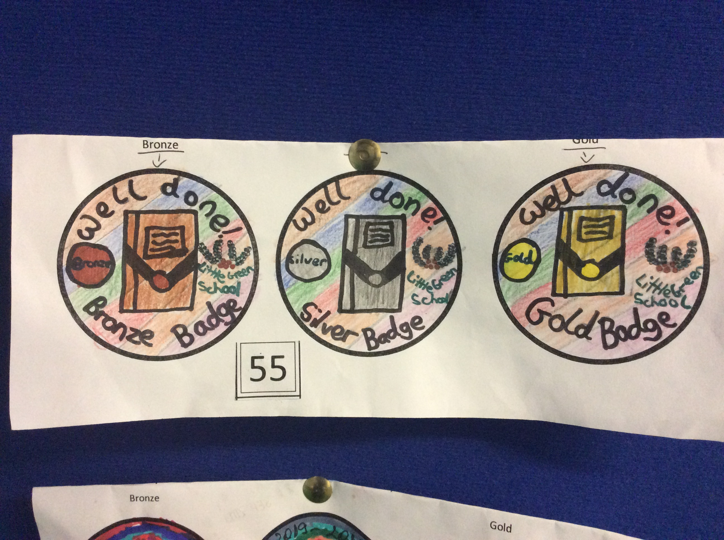
In 4th place
Emma 6R

Slide 7
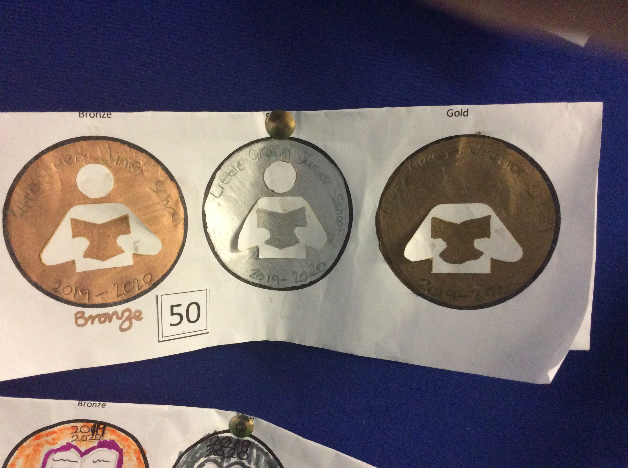
In 3rd place
Amaan 3E

Slide 8
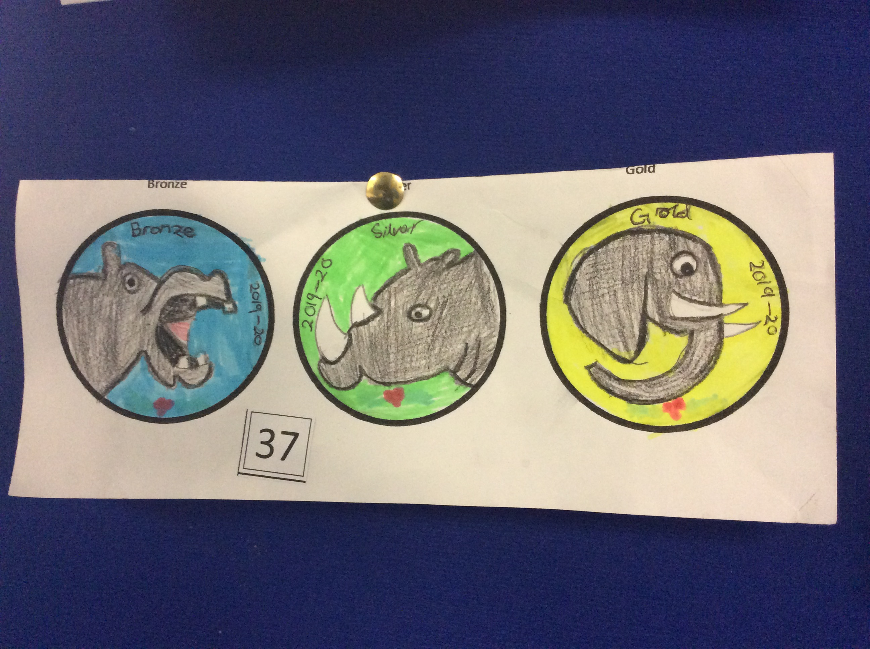
In 2nd place
Sophia
4E

Slide 9
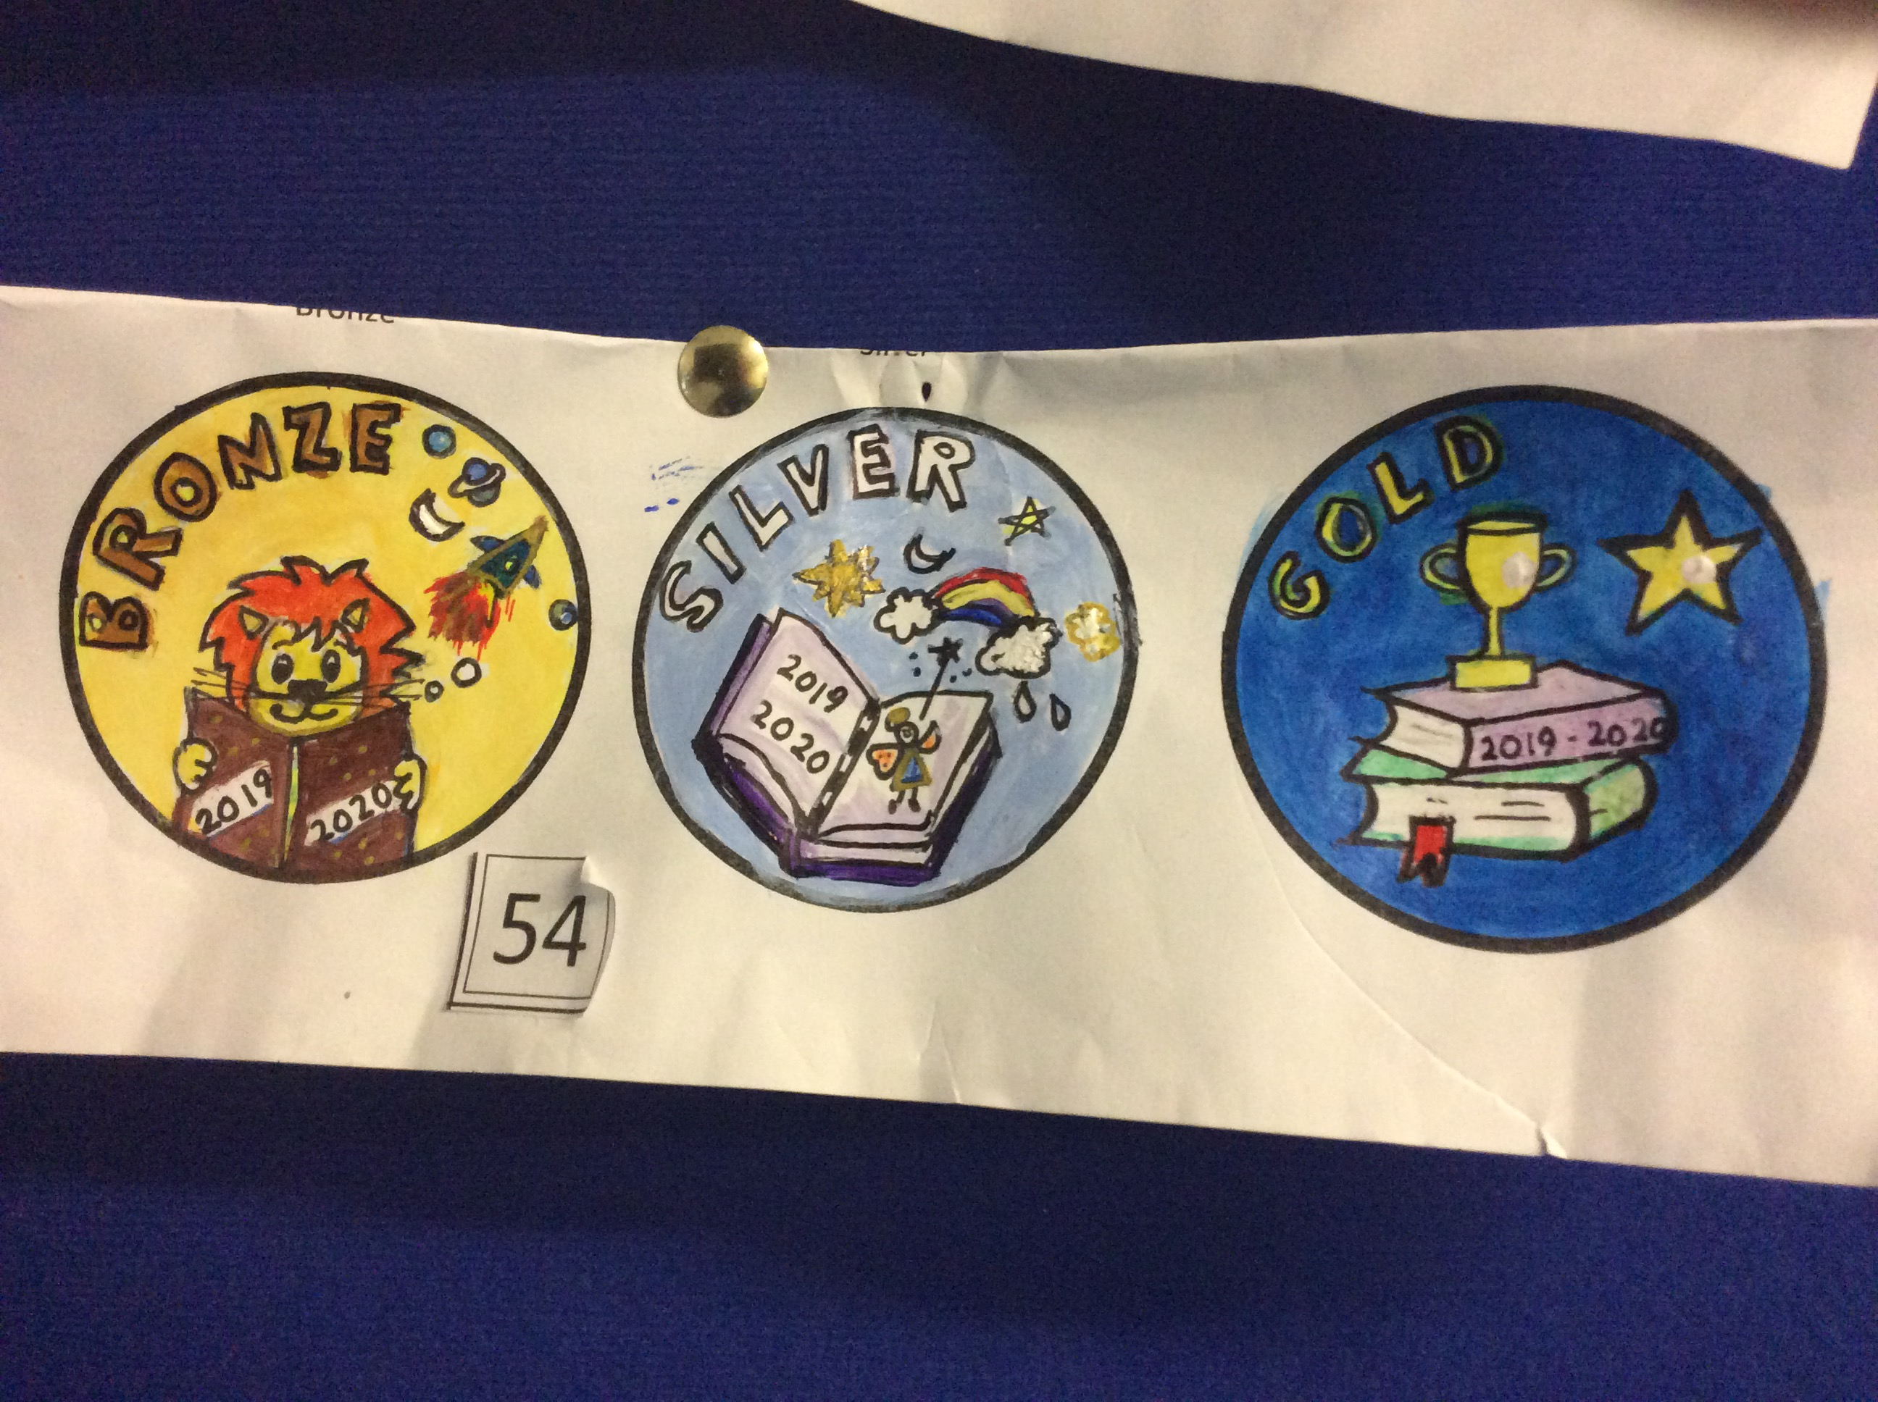
The winner…
Neel
6E

Slide 10
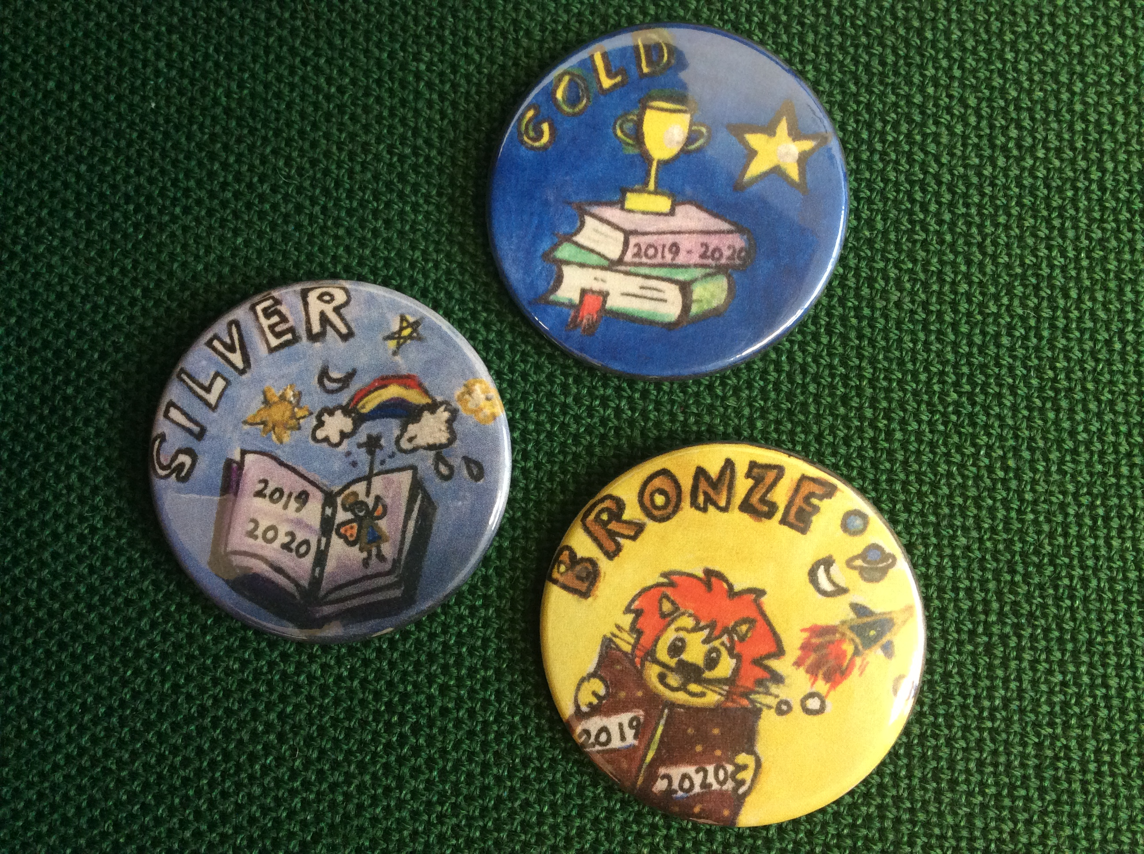

Slide 11
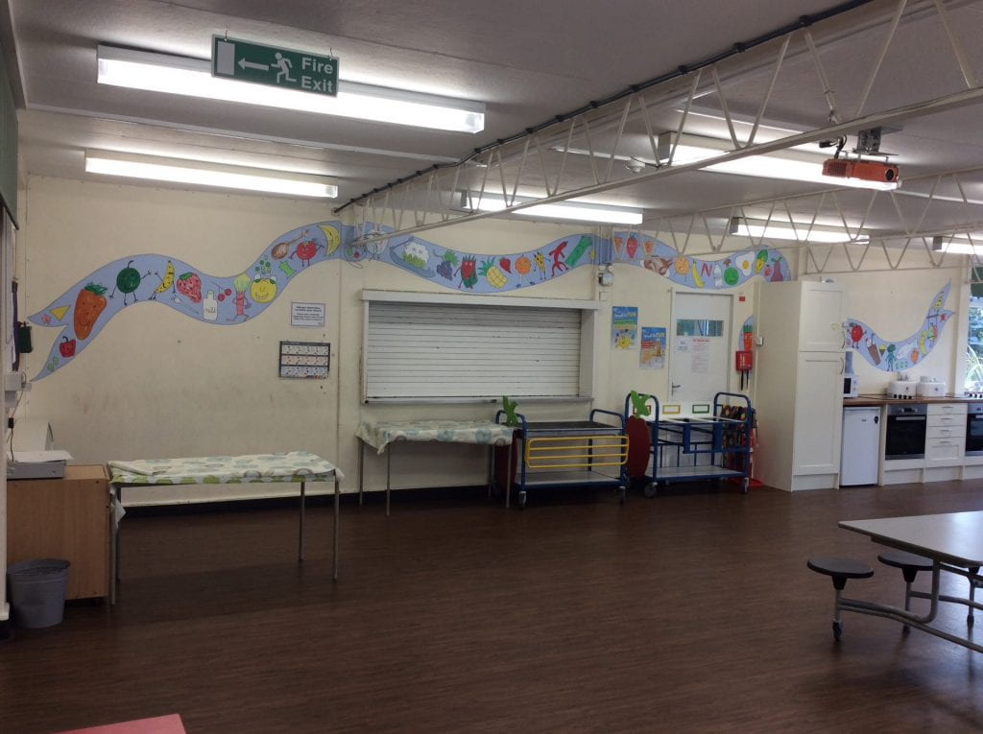
Canteen competition – votes and results coming soon…

Slide 12
What could our next competition be?
USE MY
Suggestion box!

